Slide 1


EXL RAGathon CHALLENGE
PRESENTED BY AI
WARRIORS

Slide 2

Introduction
Innovative Tool: Multi PDF Chat App is a Python-based tool designed to facilitate interaction with multiple PDF documents.
Natural Language Interface: Users can query PDF contents using everyday language through a chat interface.
Advanced Language Models: The app utilizes advanced language models to provide precise and accurate responses to user inquiries.
Efficient Document Exploration: Manual searches and cumbersome navigation are eliminated, enhancing productivity.
Intuitive Interface: With a user-friendly interface, navigating through PDFs becomes effortless.
Scalability: Whether handling a few documents or an extensive library, the app adapts seamlessly to user needs.

Slide 3
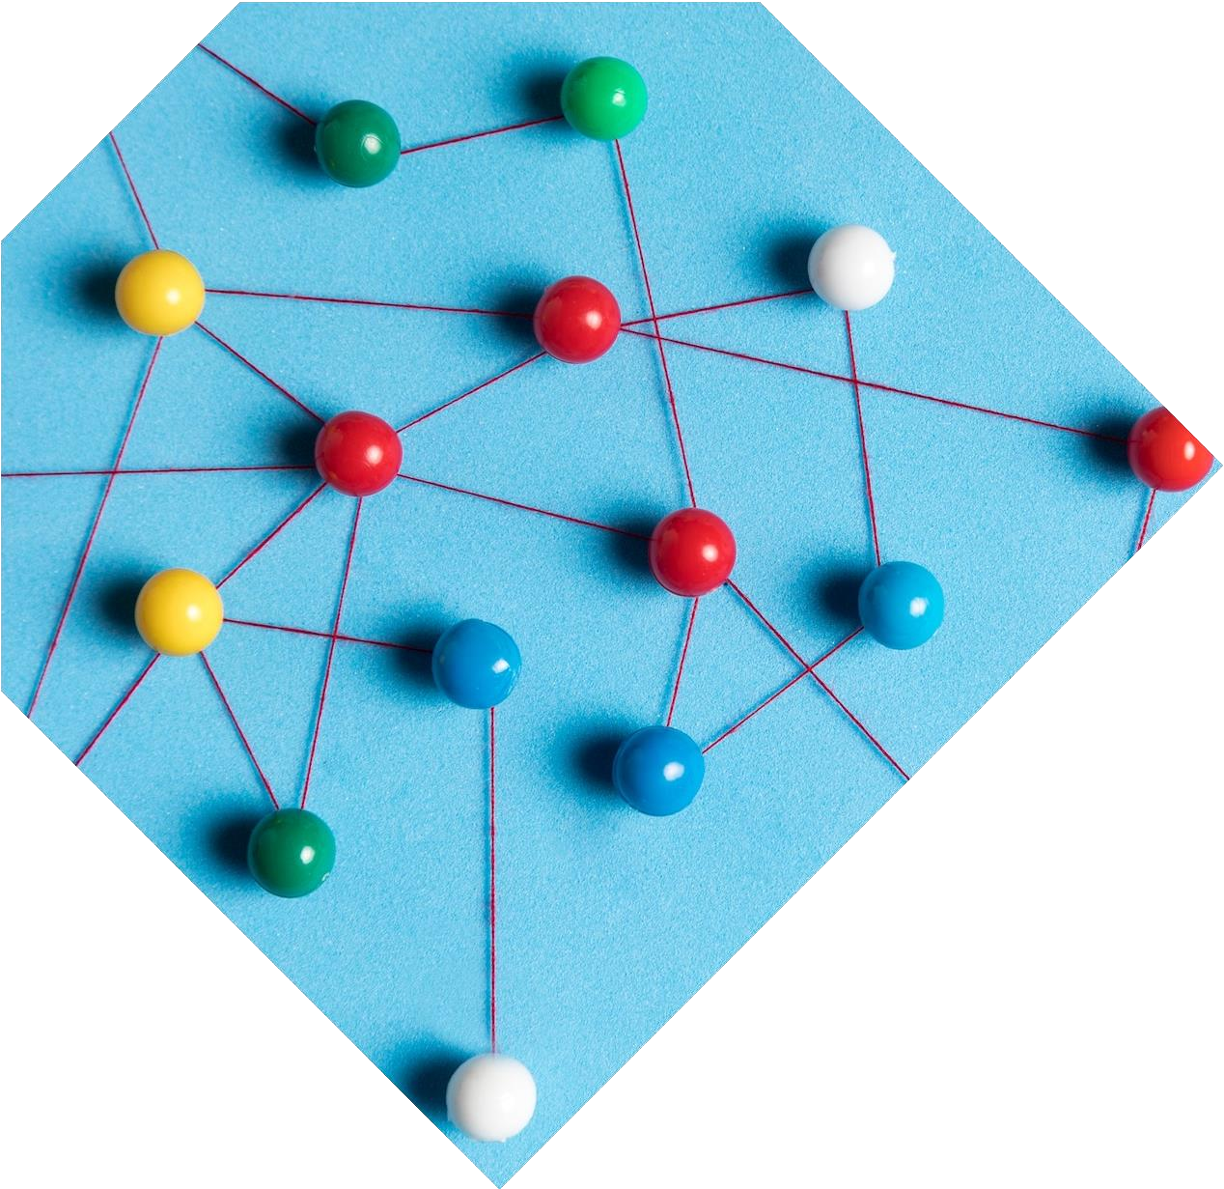
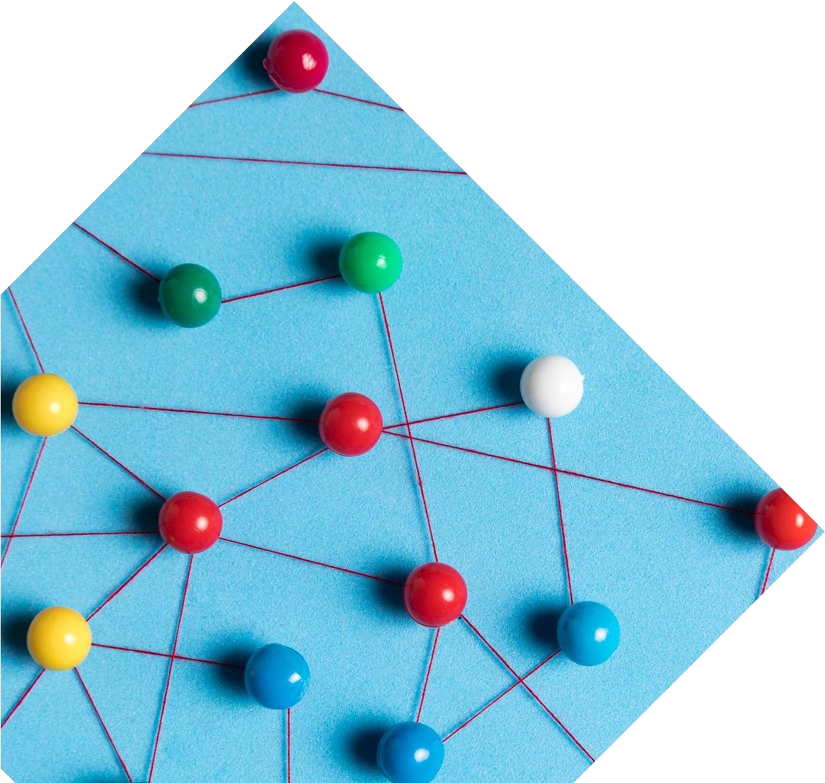
Components of Chatbot
User Interface: The interface allows users to input questions or queries regarding the content of uploaded PDF documents.
PDF Processor: The bot extracts text from uploaded PDFs, enabling analysis and response generation.
Language Model: Utilizes advanced language models to understand user queries and generate appropriate responses.
Conversation Memory: Maintains a history of conversations to ensure contextually relevant

Slide 4
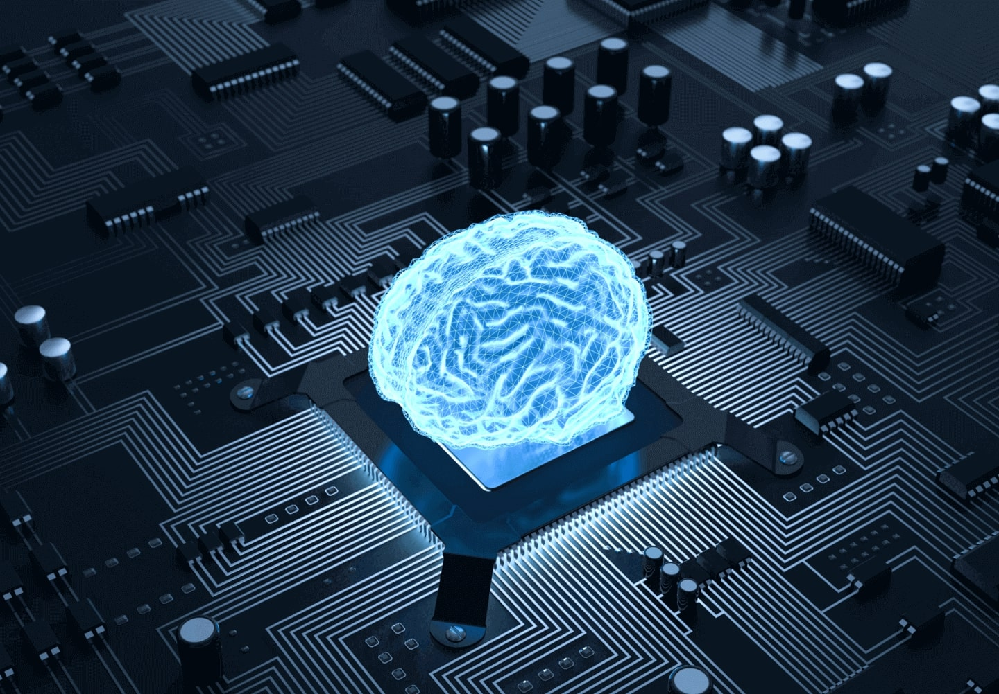
Workflow
PDF Loading: The application scans multiple PDF files and extracts the text within them.
Text Chunking: The obtained text is divided into manageable chunks, preparing it for further processing.
Language Model Integration: Sophisticated language models are integrated to convert text chunks into vector representations known as embeddings.
Similarity Matching: User queries are compared with text chunks to identify those with the highest semantic resemblance, facilitating precise information retrieval.
Response Generation: Isolated text chunks undergo processing by the language model to generate responses that accurately reflect the content of the PDFs.

Slide 5

Applications
Research Assistance: Enables researchers to extract relevant information from academic papers and research articles for literature reviews and scholarly analysis.
Educational Support: Helps students clarify concepts and obtain summaries from textbooks and educational materials, enhancing their learning experience.
Business Intelligence: Facilitates data extraction and analysis from business reports and financial statements, aiding in decision-making processes.
Document Management: Improves document retrieval and knowledge sharing within organizations by efficiently accessing information from a vast repository of documents.
Customer Support: Enhances customer service by providing quick answers to frequently asked questions and assisting customers in accessing product manuals and guides.
Compliance and Regulation: Assists compliance officers and regulatory professionals in navigating regulatory documents and ensuring adherence to industry standards.

Slide 6

Code For The Project
Imports:
Import necessary libraries:
`streamlit`, `dotenv`, `PyPDF2`.
Additional modules from `langchain` and `htmlTemplates`.
Functions:
`get_pdf_text(pdf_docs)`: Extracts text from PDFs.
`get_text_chunks(text)`: Splits text into manageable chunks.
`get_vectorstore(text_chunks)`: Converts text chunks into vectors.
`get_conversation_chain(vectorstore)`: Initializes a conversation.
`handle_userinput(user_question)`: Processes user input and
displays chat history.
Main Function (`main()`):
Configures Streamlit page.
Initializes session state variables.
Displays web app header.
Provides text input field for user queries.
Sidebar allows PDF upload and processing initiation.
Extracts text, creates vector store, and initializes conversation chain.
Displays user queries and chatbot responses.

Slide 7
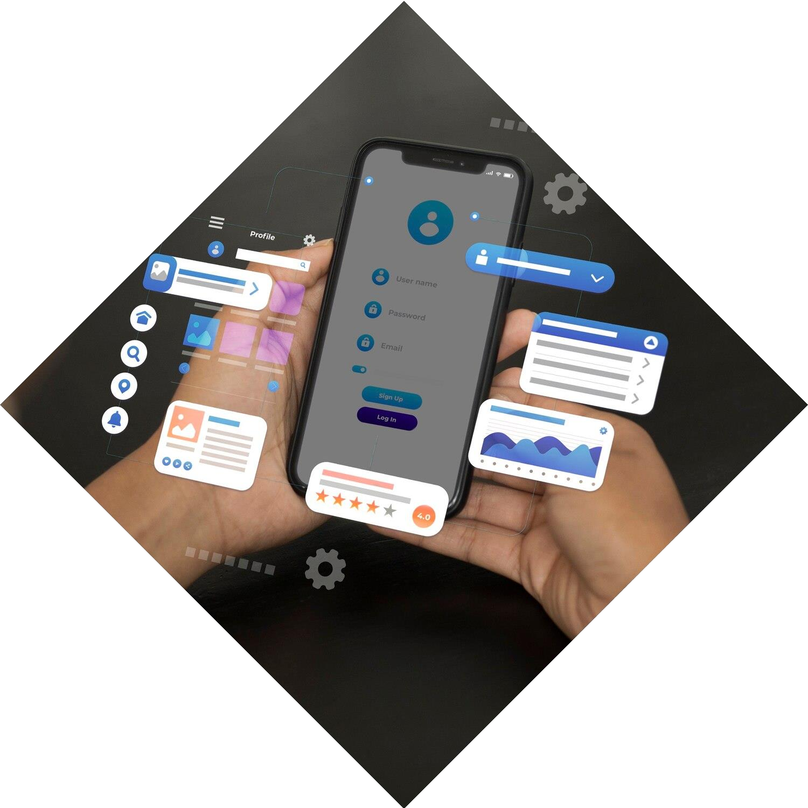
Outcome
Efficiency: Users efficiently access information from multiple PDFs through natural language queries, saving time.
Productivity Boost: Researchers focus more on analysis, less on manual search, improving overall productivity.
Collaboration: Facilitates team collaboration by providing a central platform for discussing document contents.
User-Friendly: Simple interface enhances user experience, promoting ease of interaction.
Scalability : Codebase is adaptable and scalable to accommodate varying document volumes and future needs.
Development Potential: Foundation laid for future enhancements like summarization, keyword extraction, and database integration.

Slide 8

Future Developments
Summarization: Implement document summarization for quick insights.
Keyword Extraction: Identify key terms within PDFs for content analysis.
Database Integration: Expand accessible documents for better retrieval.
Advanced NLP Models: Improve chatbot understanding and responses.
Accessibility Features: Ensure usability for individuals with disabilities.
Performance Optimization: Enhance scalability and responsiveness.

Slide 9
Conclusion
The MultiPDF Chatbot project marks a significant advancement in document interaction and knowledge retrieval. Leveraging cutting-edge natural language processing techniques, it offers users a streamlined platform to access information from multiple PDF documents effortlessly.
Moving forward, the project holds immense potential for further development. Integrating features like document summarization, keyword extraction, and database integration will enhance its capabilities. Improvements to user interface, security, and performance will ensure a seamless and robust user experience.
In summary, the MultiPDF Chatbot is poised to revolutionize document interaction, empowering users with smarter and more efficient access to information.

Slide 10
Thanks!
Do you have any questions?
souvik.sasmal.me23@heritageit.edu.in
+91 6289185615
abhishek.kumarsingh.me23@heritageit.edu.in
+91 8240507149
GitHub https://github.com/souviksas2001/Chatbot-For- Multiple-PDF.git

